Slide 1

All Pairs Shortest Paths {Floyd}

Slide 2
What we are going to discuss
The problem
The Strategy
The Algorithm
The Analysis
1
2
3
4

Slide 3
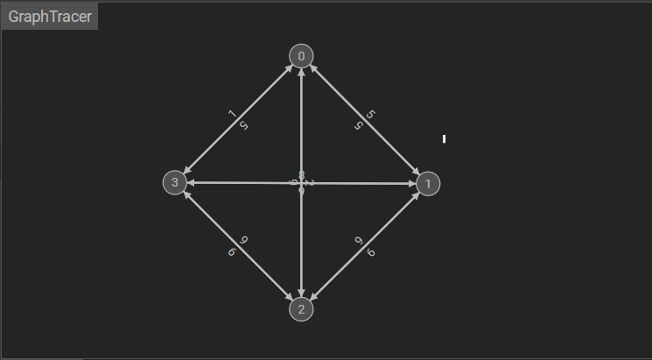
The Problem
Given a weighted graph of 4 nodes , the goal is to find the shortest path between every pair of nodes.

Slide 4
The Strategy
Key Characteristics of the Strategy:
The use of a matrix to store distances between all pairs of nodes.
Iterative exploration and updating of the matrix by considering all possible intermediate nodes.
Dynamic programming nature, which is build up solutions to subproblems to find the overall solution.

Slide 5
Apply the strategy to the problem
Step 1: Initialization Initialize a matrix S to represent the shortest distances between all pairs of nodes.
The Matrix :
0 1 2 3
0 0 5 5 3
1 4 0 1 5
2 4 8 0 1
3 6 1 6 0
Each entry (i, j) represents the weight of the edge from node i to node j.

Slide 6
Apply the strategy to the problem
step 2:Iterative Exploration
we do that by having triple nested loop structure to iteratively explore and update the shortest paths between all pairs of nodes: using the formula
distance[i][j] = min(distance[i][j], distance[i][k] + distance[k][j])
The final answer will be as:
0 1 2 3
0 0 5 5 3
1 4 0 1 5
2 4 1 0 1
3 6 5 6 0
Where K= 3

Slide 7
Apply the strategy to the problem
Repeated Exploration:
The process repeats until all possible intermediate nodes have been considered, and the distance matrix S is updated to contain the shortest paths.
Result:
After the algorithm completes, the matrix S holds the shortest distances between all pairs of nodes in the graph.

Slide 8
The Floyd-Warshall algorithm efficiently finds the shortest paths between all pairs of nodes in a weighted graph.
the algorithms and analysis

Slide 9


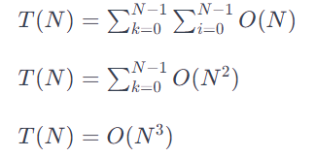
Solving the time complexity by Summation:
Now, let's express the total number of basic operations using summation notation.
Since the constant-time operations are performed n times inside the innermost loop:
Now, we simplify the summation:

Slide 10

Solving the time complexity using recurrences.
The triple nested loop in the Floyd-Warshall algorithm can be represented by the following recurrence relation:
subtraction T(N-1)
Continue to subtract and simplify
And the solution will be
The algorithm is efficient: for small to moderately sized graphs but may become impractical for very large graphs

